Slide 1

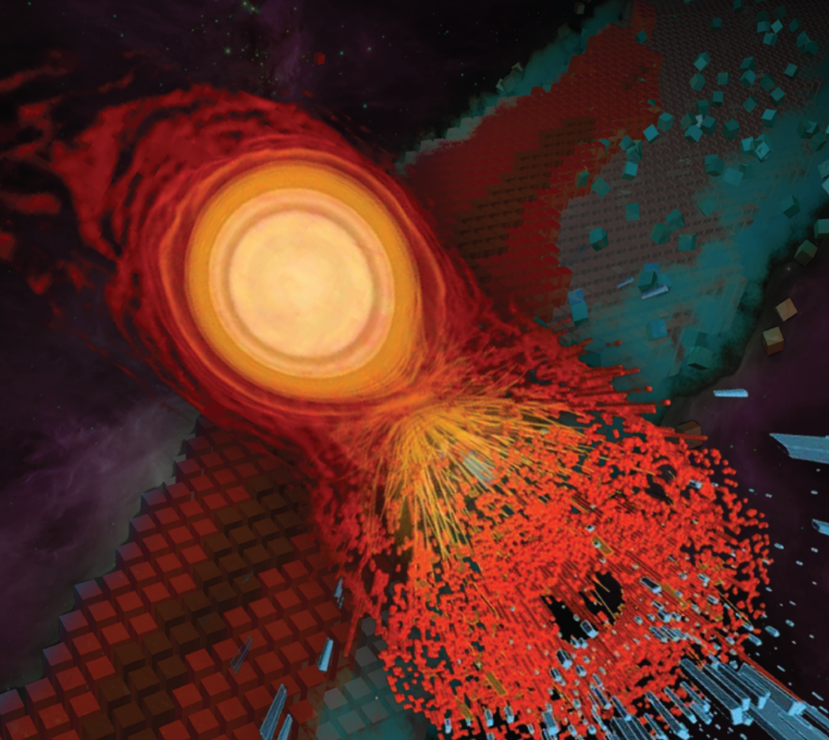



Better knowing what we don’t know
Bayesian Uncertainty Quantification Methods
Pablo Giuliani
giulia27@msu.edu
ASCSN

Slide 2
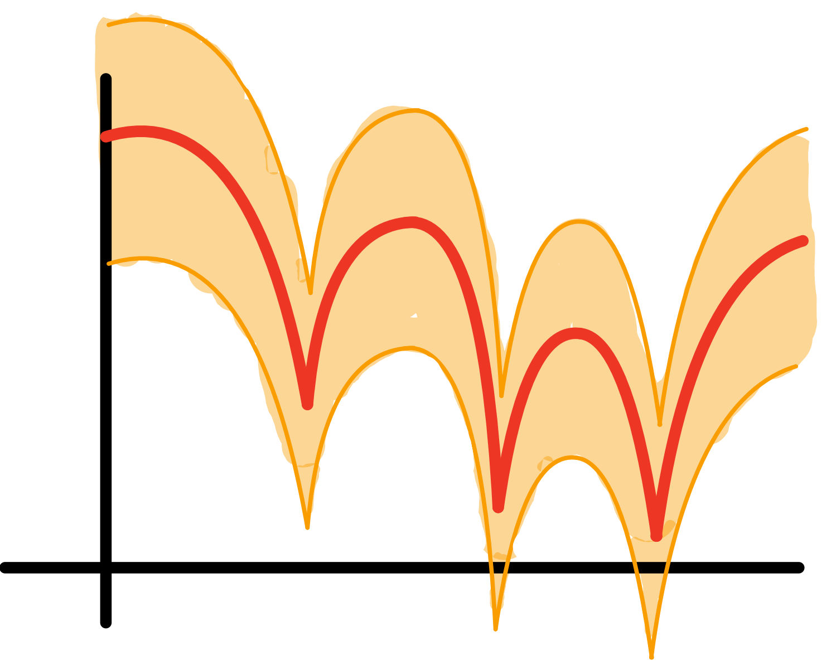
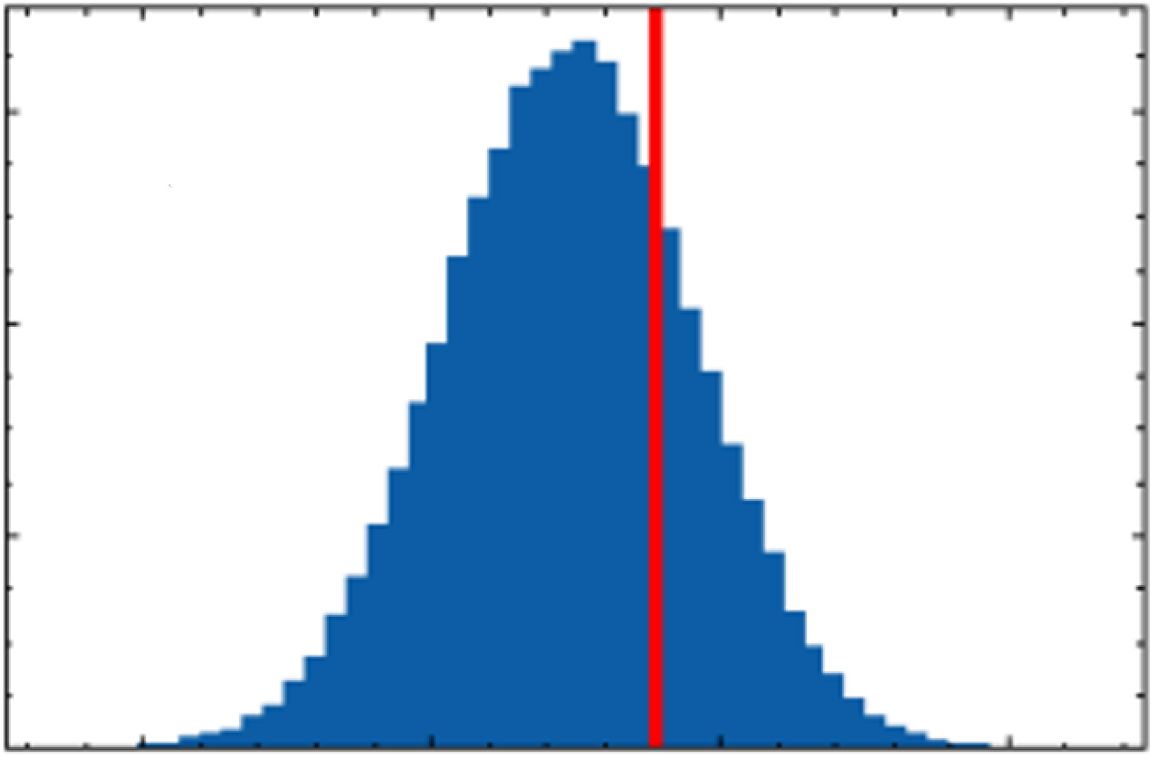


What to get from today
Why Uncertainty Quantification?
How to do it?
UQ is a model
Seek statistics friends
Hands on examples

Slide 3

What to get from today
Why Uncertainty Quantification?
How to do it?
UQ is a model
Seek statistics friends
Hands on examples
Ask questions

Slide 4
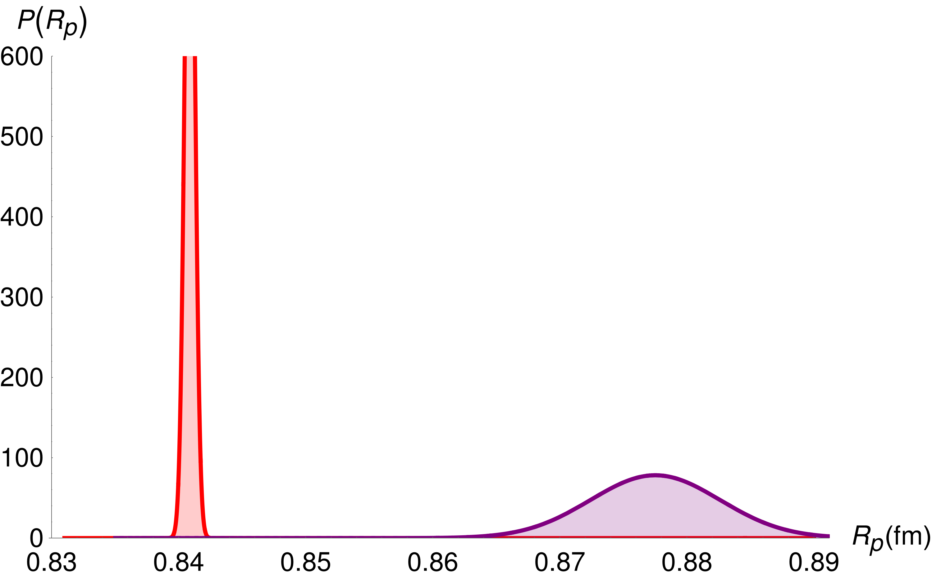

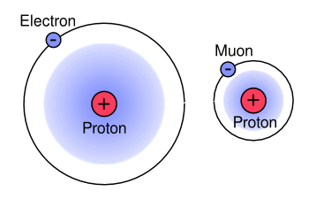

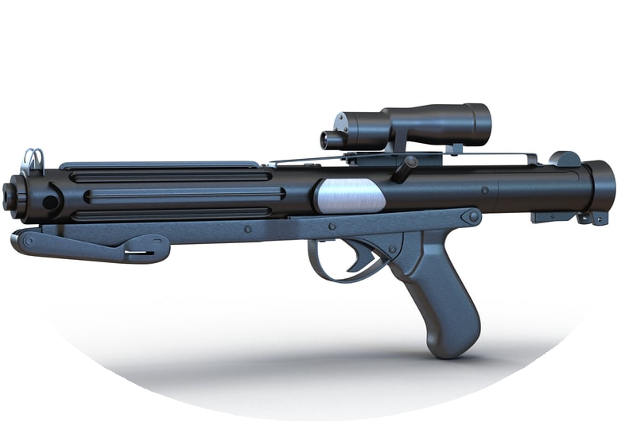
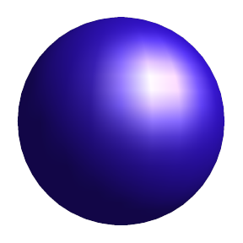
Why Uncertainty Quantification?
Reason 1
Muonic result
0.84 fm
~
Electronic result
0.88 fm
~
Proton Puzzle
2010
Spectroscopy
Scattering

Slide 5
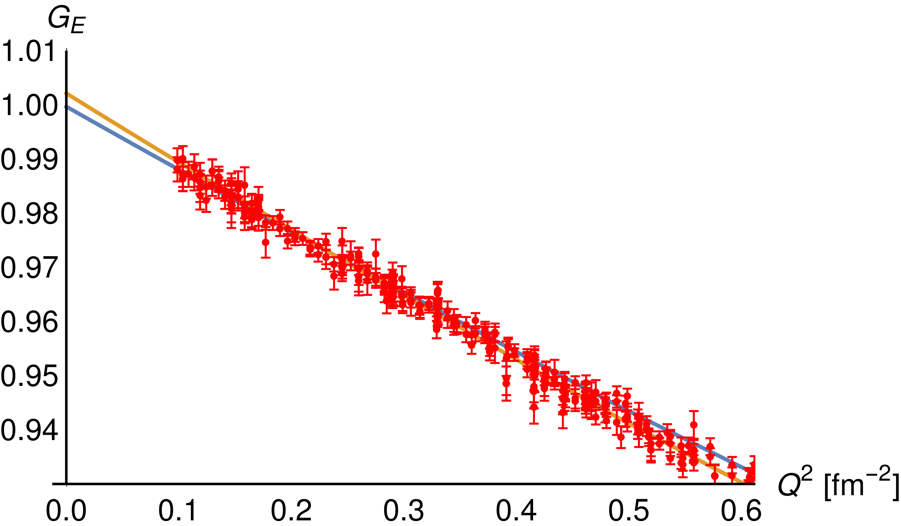
Why Uncertainty Quantification?
Reason 1
Muonic result
0.84 fm
~
Electronic result
0.88 fm
~
Proton Puzzle
2010
0.88 fm
Spectroscopy
Scattering
0.84 fm

Slide 6

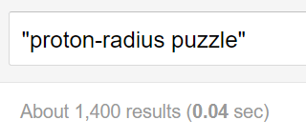
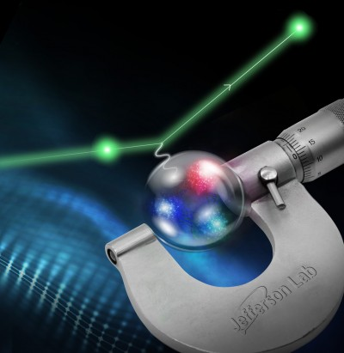

Why Uncertainty Quantification?
Reason 1
Muonic result
0.84 fm
~
Proton Radius Experiment
(PRad)
Electronic result
0.88 fm
~
Muon Proton Scattering Experiment (MUSE)

Slide 7
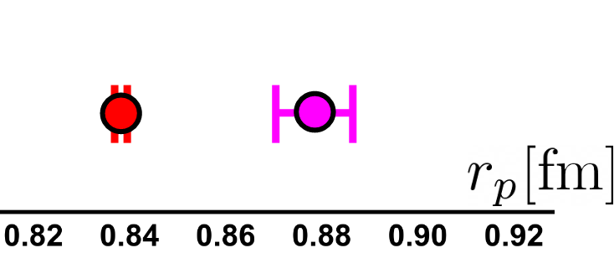
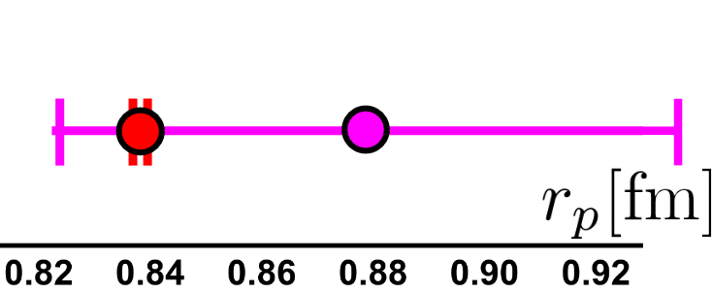
Why Uncertainty Quantification?
Reason 1
Muonic result
0.84 fm
~
Proton Radius Experiment
(PRad)
Electronic result
0.88 fm
~
What if in 2010…
Puzzle
Muon Proton Scattering Experiment (MUSE)
Refinement?

Slide 8
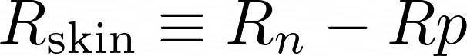
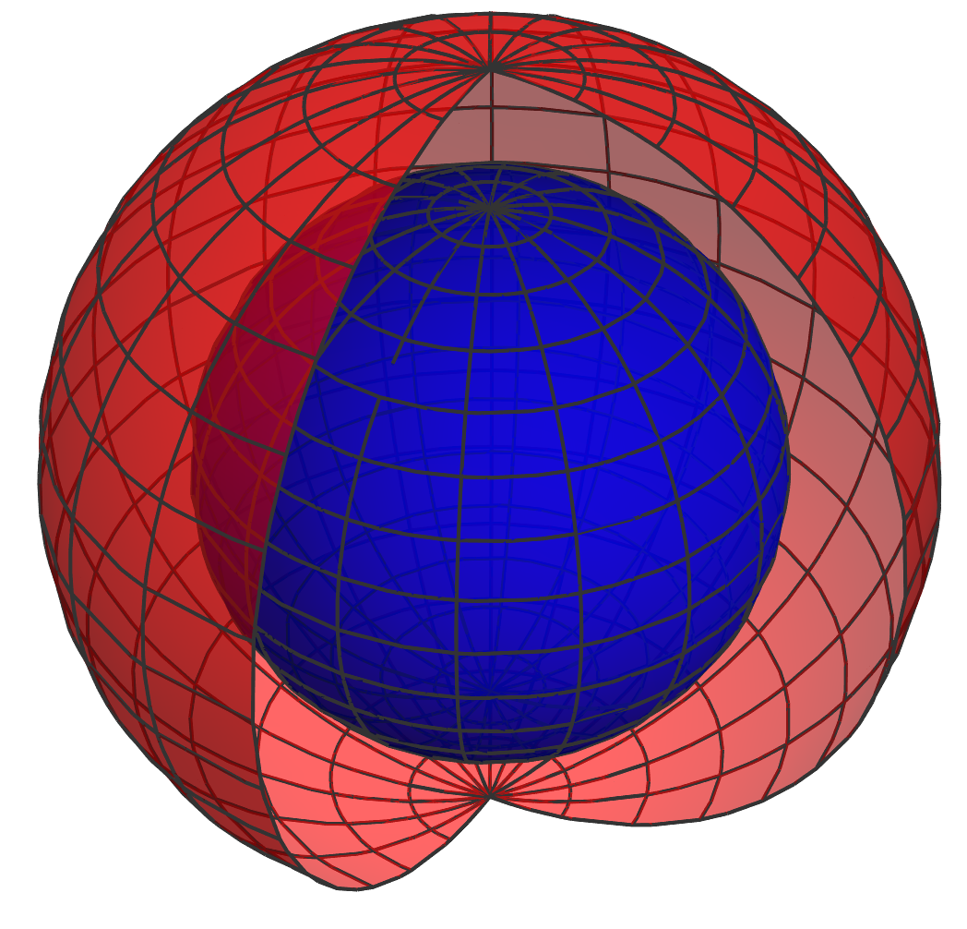
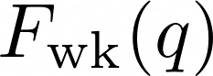
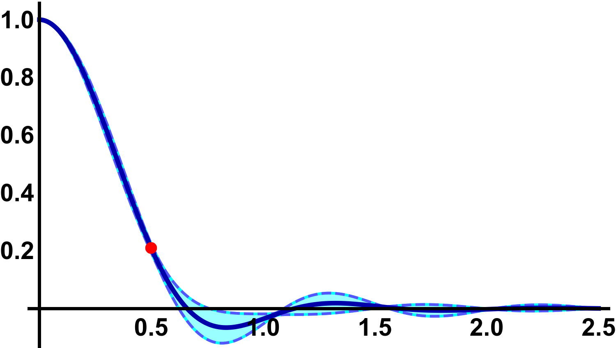



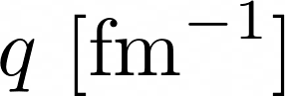
Why Uncertainty Quantification?
Reason 2
Neutrons
Protons
Theory
friend
Exp.
friend

Slide 9
Why Uncertainty Quantification?
Reason 2
Neutrons
Protons
Very expensive
experiment
Theory
friend
Exp.
friend

Slide 10
Why Uncertainty Quantification?
Reason 2
Neutrons
Protons
Maximum
Variability
(uncertainty)
Theory
friend
Exp.
friend

Slide 11
Why Uncertainty Quantification?
Reason 2
1 interest
“easy”
Neutrons
Protons
1 model
Maximum
Variability
(uncertainty)
1 experiment
Theory
friend
Exp.
friend

Slide 12
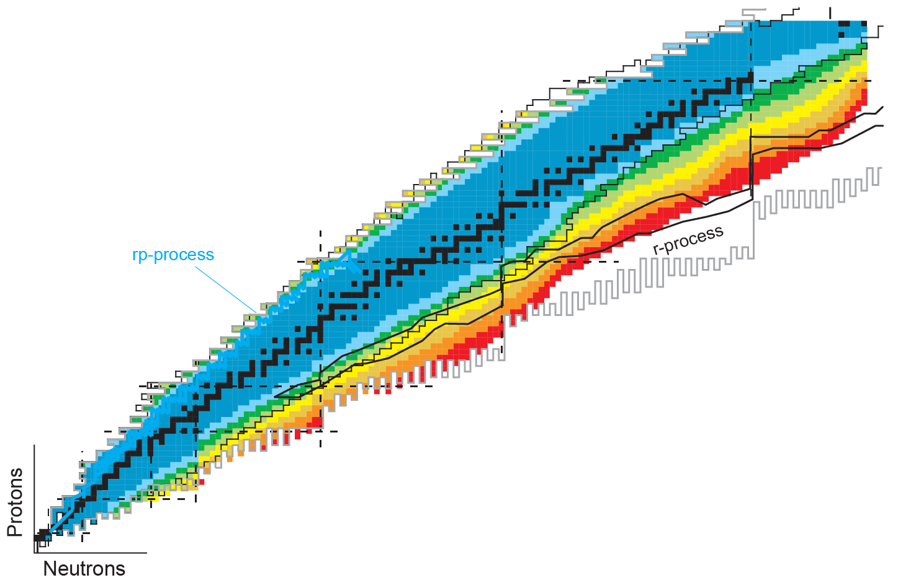
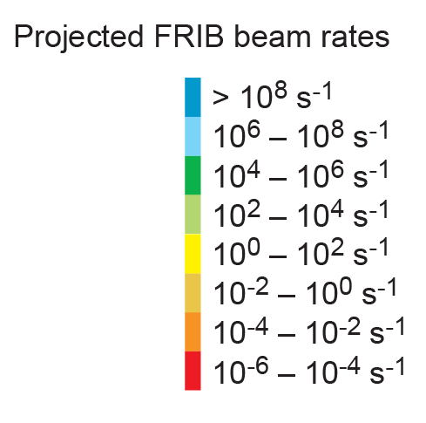
Why Uncertainty Quantification?
Reason 2
Applications
Many interests
Structure
Symmetries
Astrophysics
Figure adapted from A. Spyrou

Slide 13

Why Uncertainty Quantification?
Reason 2
r-process
Applications
Many interests
Lifetimes
(Fission)
Symmetries
(β decay)
Structure
Masses
Capture
rates
…
Astrophysics
Figure adapted from A. Spyrou

Slide 14
Why Uncertainty Quantification?
Reason 2
r-process
Applications
Many interests
Lifetimes
(Fission)
Symmetries
(β decay)
Structure
Masses
Capture
rates
…
Astrophysics
Many models
UNEDF#
SV-min
SkM*
HFB#
FRDM#
…
Figure adapted from A. Spyrou

Slide 15
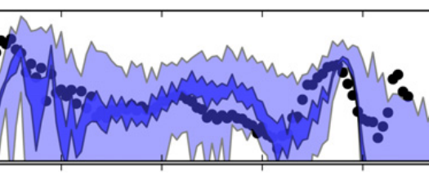
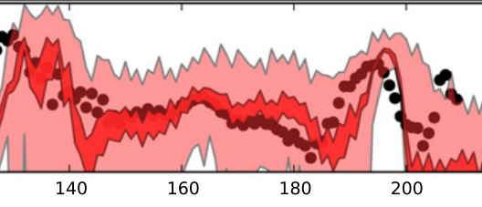
Why Uncertainty Quantification?
Reason 2
r-process
Applications
Many interests
Lifetimes
(Fission)
Symmetries
(β decay)
Structure
Masses
Capture
rates
…
Astrophysics
Many models
UNEDF#
SV-min
SkM*
HFB#
FRDM#
…
Abundances:
A
Adapted from: The impact of individual
nuclear properties on r-process
nucleosynthesis, Mumpower et al,
(2016)
Figure adapted from A. Spyrou

Slide 16
Why Uncertainty Quantification?
Reason 2
r-process
Applications
Many interests
Lifetimes
(Fission)
Symmetries
(β decay)
Structure
Masses
Capture
rates
…
Astrophysics
Many models
UNEDF#
SV-min
SkM*
HFB#
…
FRDM#
Abundances:
A
Adapted from: The impact of individual
nuclear properties on r-process
nucleosynthesis, Mumpower et al,
(2016)
Many experiments,
many nuclei
Figure adapted from A. Spyrou

Slide 17

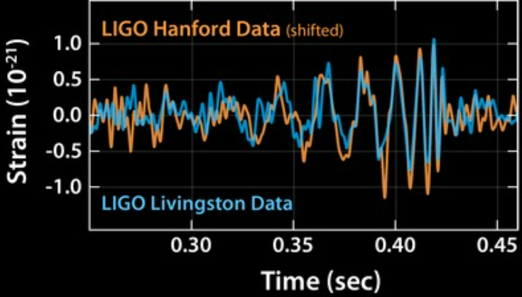
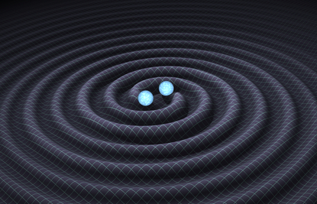
Why Uncertainty Quantification?
Reason 2
r-process
Applications
Many interests
(Fission)
https://www.ligo.caltech.edu/image/ligo20160211a
Lifetimes
(β decay)
Structure
Symmetries
Masses
Capture
rates
…
Astrophysics
Many models
UNEDF#
SV-min
SkM*
HFB#
…
FRDM#
Abundances:
Many observations
A
Adapted from: The impact of individual
nuclear properties on r-process
nucleosynthesis, Mumpower et al,
(2016)
Many experiments,
many nuclei
Figure adapted from A. Spyrou

Slide 18
Why Uncertainty Quantification?
Reason 2
r-process
Applications
Many interests
(Fission)
https://www.ligo.caltech.edu/image/ligo20160211a
Lifetimes
(β decay)
Structure
Symmetries
Masses
Capture
rates
…
Astrophysics
Many models
UNEDF#
SV-min
SkM*
HFB#
…
FRDM#
Abundances:
Many observations
Not so easy
A
Adapted from: The impact of individual
nuclear properties on r-process
nucleosynthesis, Mumpower et al,
(2016)
Many experiments,
many nuclei
Figure adapted from A. Spyrou

Slide 19
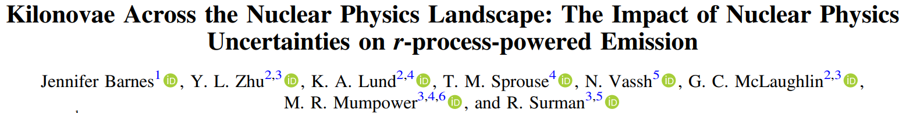
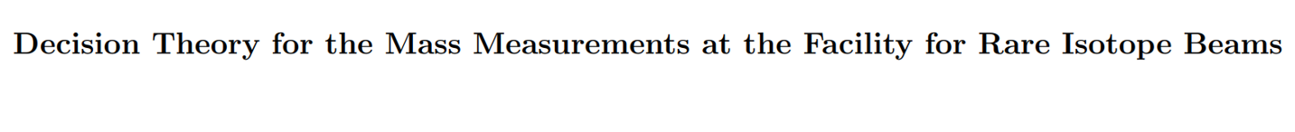
Why Uncertainty Quantification?
Reason 2
r-process
Applications
Many interests
(Fission)
https://www.ligo.caltech.edu/image/ligo20160211a
Lifetimes
(β decay)
Structure
Symmetries
Masses
Capture
rates
…
Astrophysics
Many models
UNEDF#
SV-min
SkM*
HFB#
…
FRDM#
Abundances:
Many observations
Not so easy
A
Adapted from: The impact of individual
nuclear properties on r-process
nucleosynthesis, Mumpower et al,
(2016)
Many experiments,
many nuclei
Figure adapted from A. Spyrou

Slide 20
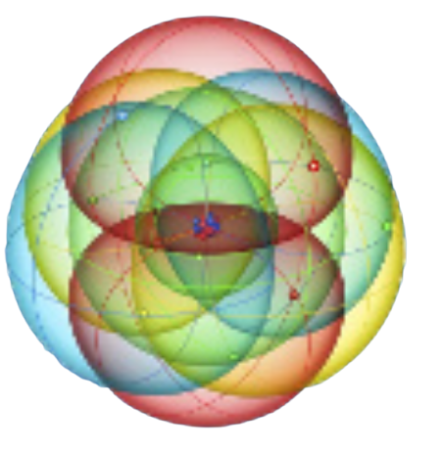
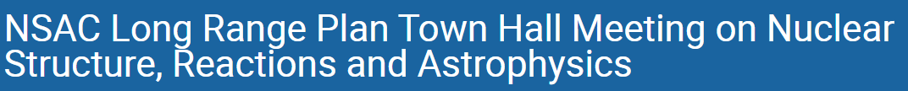
Why Uncertainty Quantification?
Bonus reasons
Nov 14 – 16, 2022

Slide 21

Why Uncertainty Quantification?
Bonus reasons
Nov 14 – 16, 2022

Slide 22
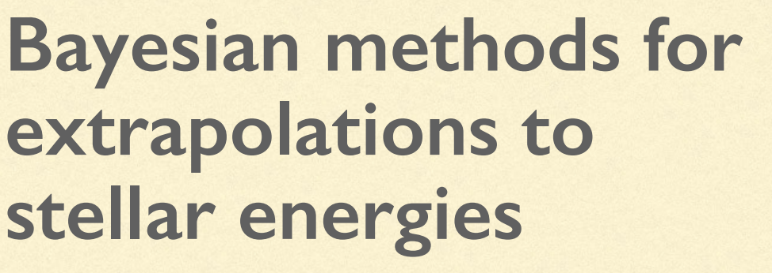
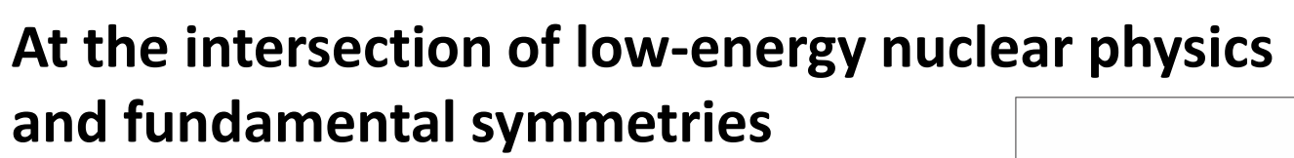
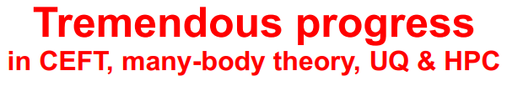

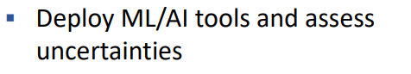
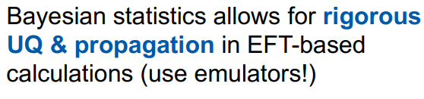

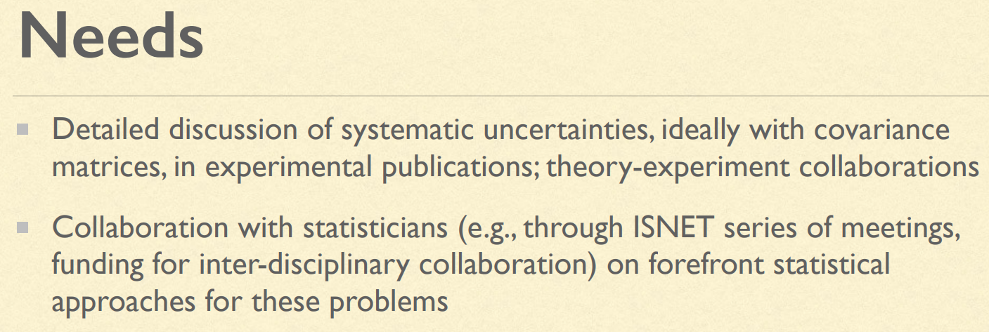



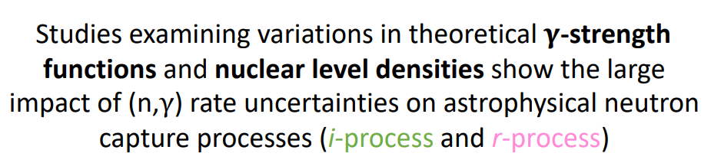
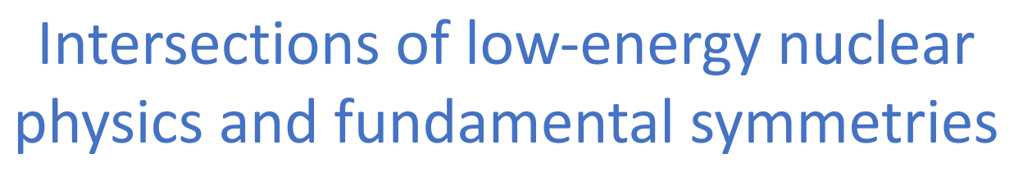
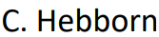
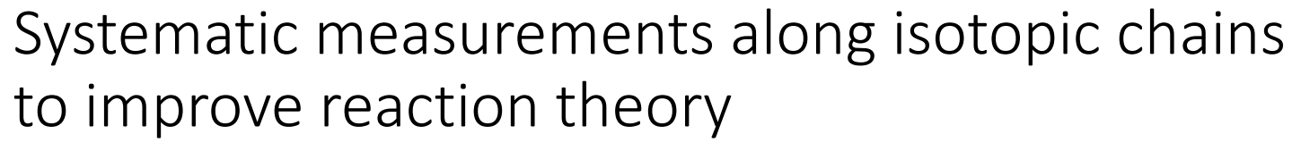
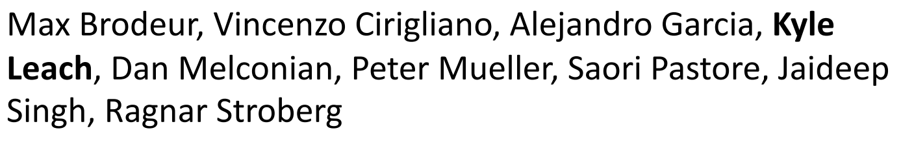

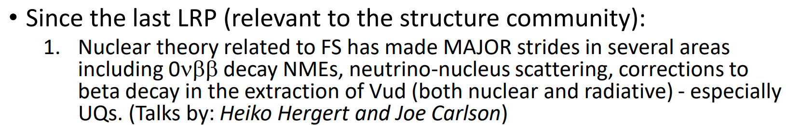

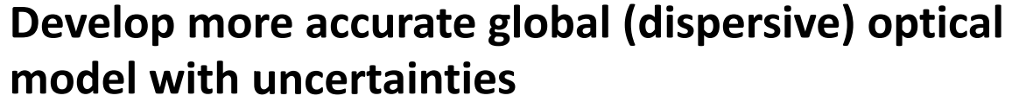
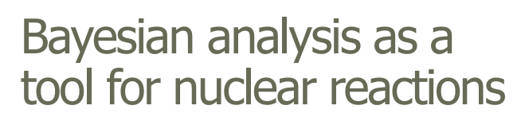
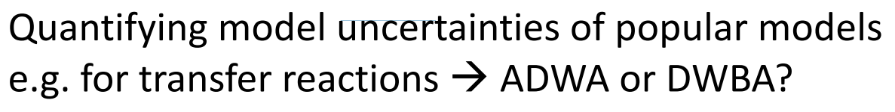

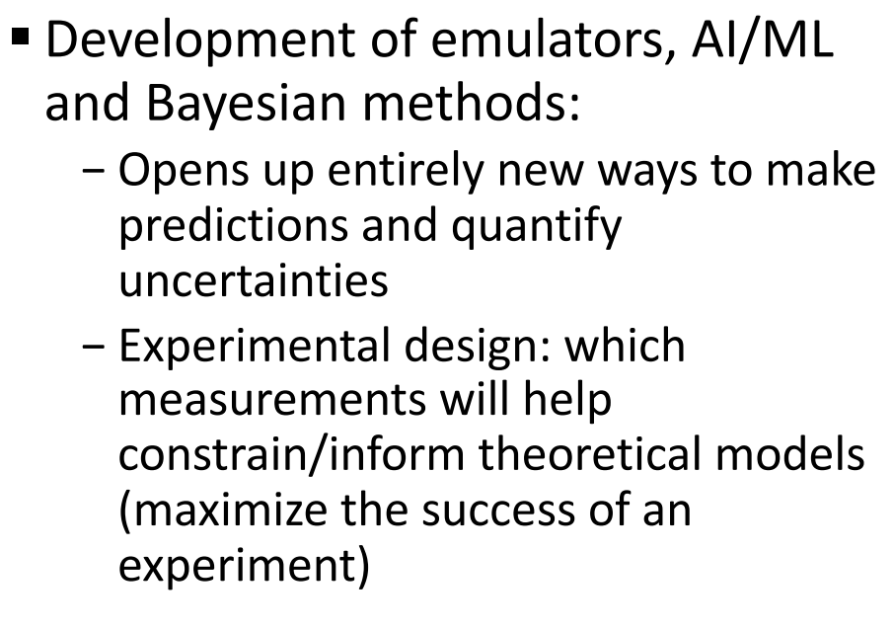
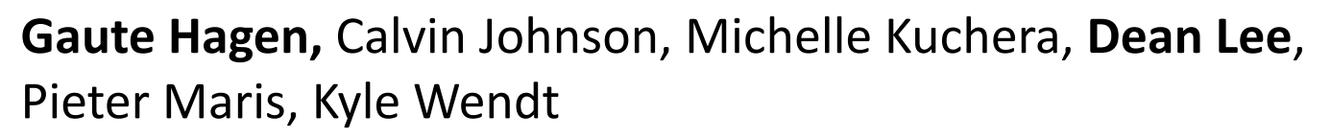

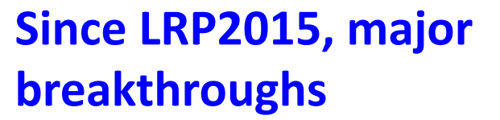
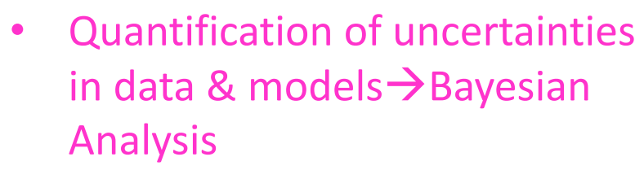
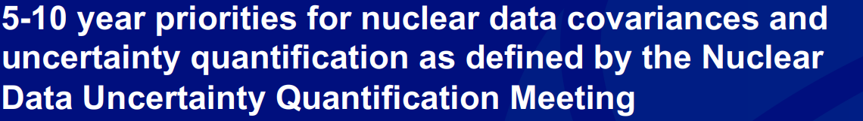

Why Uncertainty Quantification?
Bonus reasons
Nov 14 – 16, 2022
…

Slide 23
Why Uncertainty Quantification?
Bonus reasons
Nov 14 – 16, 2022
…

Slide 24
Why Uncertainty Quantification?
How

Slide 25
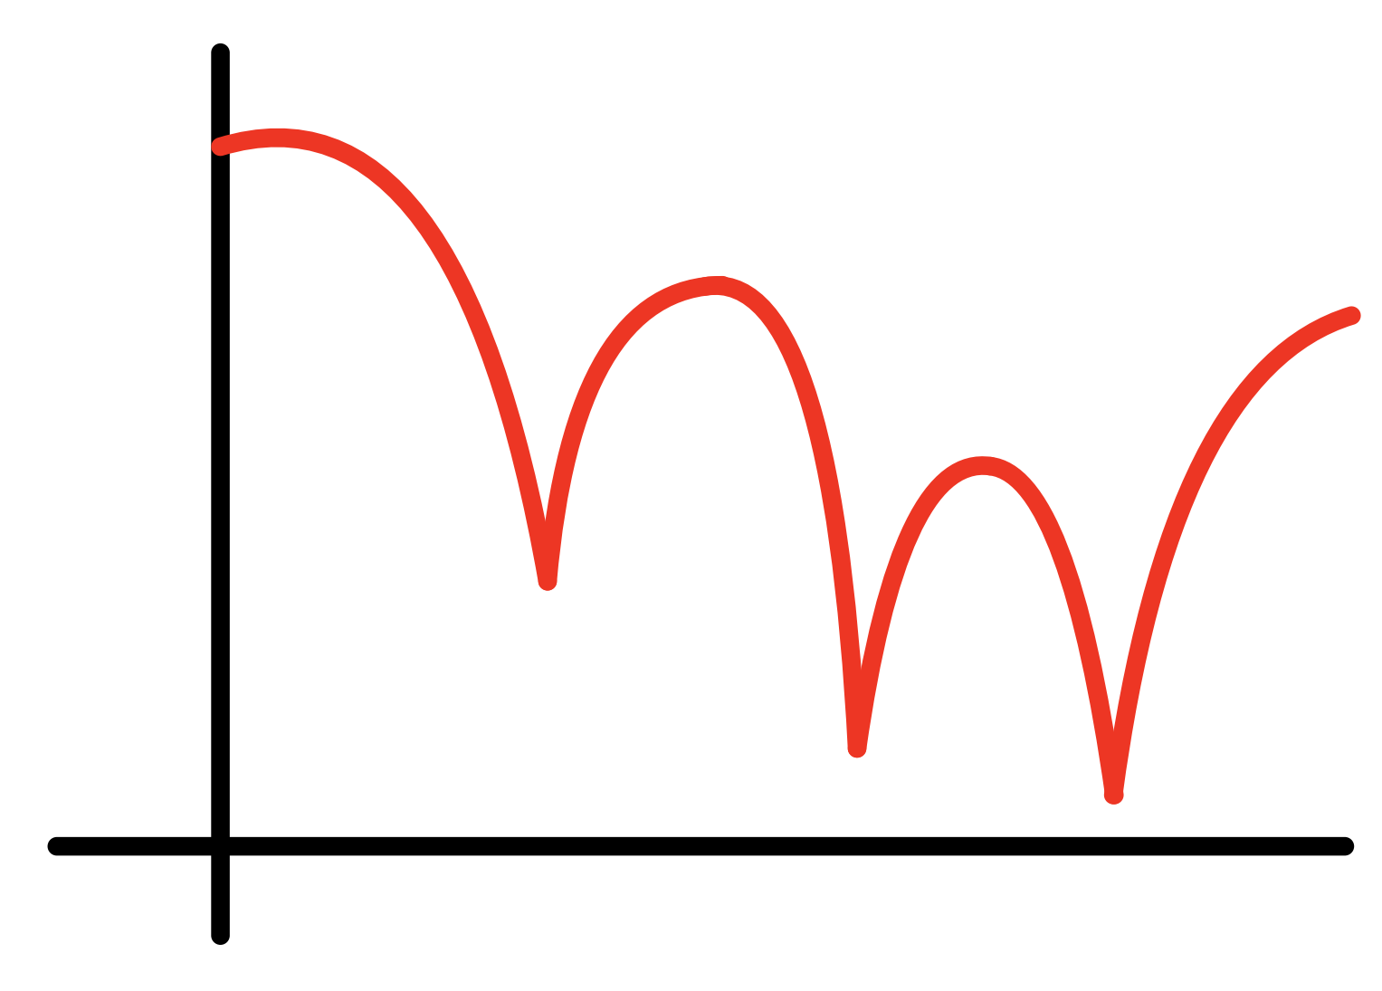


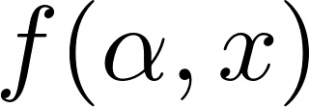
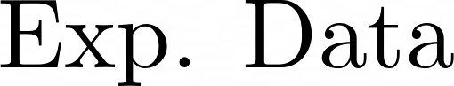

Why Uncertainty Quantification?
How
parameters
Theory
friend
Exp.
friend

Slide 26
Why Uncertainty Quantification?
How
parameters
Theory
friend
Exp.
friend

Slide 27

Why Uncertainty Quantification?
How
parameters
Bayesian statistics
1) Everything is a random variable
Theory
friend
Exp.
friend
2) Need to model their distributions
and how they interact

Slide 28
Bayesian Formulation
Advantages
1) Assumptions are clearly stated
2) Allows for natural continuous learning

Slide 29
Bayesian Formulation
Likelihood
Prior
Posterior
Evidence
Advantages
1) Assumptions are clearly stated
2) Allows for natural continuous learning

Slide 30
Bayesian Formulation
(what we think happened)
(what we think we know)
Likelihood
Prior
(what we want)
Posterior
Evidence
(how much sense all makes)
Advantages
1) Assumptions are clearly stated
2) Allows for natural continuous learning

Slide 31

Bayesian Formulation
(what we think happened)
(what we think we know)
Likelihood
Prior
(what we want)
Posterior
Evidence
(how much sense all makes)

Slide 32

Bayesian Formulation
(what we think happened)
(what we think we know)
Likelihood
Prior
(what we want)
Posterior
Evidence
(how much sense all makes)

Slide 33

Bayesian Formulation
(what we think happened)
(what we think we know)
Likelihood
Prior
(what we want)
Posterior
Evidence
(how much sense all makes)

Slide 34

Bayesian Formulation
(what we think happened)
(what we think we know)
Likelihood
Prior
(what we want)
Posterior
Evidence
(how much sense all makes)

Slide 35
Typical day of Bayes
Theory
friend
Exp.
friend
Exp.
friend

Slide 36
Typical day of Bayes
What is the previous knowledge?
Nuclear radius is around 3 fm
How much “around”?
Maybe 2.8 to 3.34?
Ok, will use skewed distributions for priors
Theory
friend
Exp.
friend
Bayes
friend

Slide 37
Typical day of Bayes
What is the previous knowledge?
Nuclear radius is around 3 fm
How much “around”?
Maybe 2.8 to 3.34?
Ok, will use skewed distributions for priors
How was the data taken?
Two detectors, one precise for x<2 and one not so good for x>2. We don’t trust much the value at x=2.3
We will use a likelihood model for each, and check the sensitivity to the x=2.3 data point
Theory
friend
Exp.
friend
Bayes
friend

Slide 38

Typical day of Bayes
Are there any other models besides
?
Theory
friend
Exp.
friend
Bayes
friend

Slide 39


Typical day of Bayes
Are there any other models besides
?
Nope, is the only one that it is consistent with the
Yes, there are!
also explains the data
Theory
friend
Exp.
friend
Theory
Friend (2)
Bayes
friend

Slide 40
Typical day of Bayes
Are there any other models besides
?
Nope, is the only one that it is consistent with the
Yes, there are!
also explains the data
But fails at small angles,
everyone knows that
That’s ok, we can mix both respecting their expertise domains
Theory
friend
Exp.
friend
Theory
Friend (2)
Bayes
friend

Slide 41

Typical day of Bayes
Are there any other models besides
?
Nope, is the only one that it is consistent with the
Yes, there are!
also explains the data
But fails at small angles,
everyone knows that
That’s ok, we can mix both respecting their expertise domains
How long it takes to evaluate each model?
Between 2 to 3
hours per
Around a second
Ok, we will
need emulators
Theory
friend
Exp.
friend
Theory
Friend (2)
Bayes
friend

Slide 42


Typical day of Bayes
math friend
Someone said
emulators??
Are there any other models besides
?
Nope, is the only one that it is consistent with the
Yes, there are!
also explains the data
But fails at small angles,
everyone knows that
computer
friend
That’s ok, we can mix both respecting their expertise domains
How long it takes to evaluate each model?
Between 2 to 3
hours per
Around a second
Ok, we will
need emulators
Theory
friend
Exp.
friend
Theory
Friend (2)
Bayes
friend

Slide 43




Typical day of Bayes
math friend
computer
friend
Theory
friend
Exp.
friend
Theory
Friend (2)
Bayes
friend

Slide 44


Practical example
Prior and likelihood building
Sampling from posterior
and plotting it
Calculating new things

Slide 45
Practical example
Prior and likelihood building
Sampling from posterior
and plotting it
Calculating new things
(what we think
we know)
Prior

Slide 46


Practical example
Prior and likelihood building
Sampling from posterior
and plotting it
Calculating new things
(what we think
we know)
Prior

Slide 47



Practical example
Prior and likelihood building
Sampling from posterior
and plotting it
Calculating new things
(what we think
we know)
Prior

Slide 48




Practical example
Prior and likelihood building
Sampling from posterior
and plotting it
Calculating new things
(what we think
we know)
Prior

Slide 49
Practical example
Prior and likelihood building
Sampling from posterior
and plotting it
Calculating new things
Likelihood
(what we think happened)

Slide 50



Practical example
Prior and likelihood building
Sampling from posterior
and plotting it
Calculating new things
Data point :
Likelihood
(what we think happened)

Slide 51
Practical example
Prior and likelihood building
Sampling from posterior
and plotting it
Calculating new things
Data point :
Likelihood
(what we think happened)

Slide 52


Practical example
Prior and likelihood building
Sampling from posterior
and plotting it
Calculating new things
Data point :
Likelihood
(what we think happened)

Slide 53

Practical example
Prior and likelihood building
Sampling from posterior
and plotting it
Calculating new things
Data point :
Likelihood
(what we think happened)

Slide 54

Practical example
Prior and likelihood building
Sampling from posterior
and plotting it
Calculating new things
Likelihood
(what we think happened)

Slide 55
Practical example
Prior and likelihood building
Sampling from posterior
and plotting it
Calculating new things
Likelihood
(what we think happened)

Slide 56


Practical example
Prior and likelihood building
Sampling from posterior
and plotting it
Calculating new things
Likelihood
(what we think happened)

Slide 57

Practical example
Prior and likelihood building
Sampling from posterior
and plotting it
Calculating new things
Likelihood
(what we think happened)

Slide 58

Practical example
Prior and likelihood building
Sampling from posterior
and plotting it
Calculating new things
Likelihood
(what we think happened)

Slide 59

Practical example
Prior and likelihood building
Sampling from posterior
and plotting it
Calculating new things
From this

Slide 60
Practical example
Prior and likelihood building
Sampling from posterior
and plotting it
Calculating new things
We want this
From this

Slide 61





Practical example
Markov Chain Monte Carlo (MCMC)
Prior and likelihood building
Metropolis algorithm
1) Start somewhere
Sampling from posterior
and plotting it
2) Propose new location and compute:
Calculating new things
3) Pick “s” random between [0,1]
4) If
Move to
Stay in
5) Repeat 2-4 until you get tired

Slide 62

Practical example
Markov Chain Monte Carlo (MCMC)
Metropolis algorithm
1) Start somewhere
2) Propose new location and compute:
3) Pick “s” random between [0,1]
4) If
Move to
Stay in
5) Repeat 2-4 until you get tired

Slide 63


Practical example
Markov Chain Monte Carlo (MCMC)
Metropolis algorithm
1) Start somewhere
2) Propose new location and compute:
3) Pick “s” random between [0,1]
4) If
Move to
Stay in
5) Repeat 2-4 until you get tired

Slide 64

Practical example
Markov Chain Monte Carlo (MCMC)
Metropolis algorithm
1) Start somewhere
?
2) Propose new location and compute:
3) Pick “s” random between [0,1]
4) If
Move to
Stay in
5) Repeat 2-4 until you get tired

Slide 65

Practical example
Markov Chain Monte Carlo (MCMC)
Metropolis algorithm
1) Start somewhere
We move!
2) Propose new location and compute:
3) Pick “s” random between [0,1]
4) If
Move to
Stay in
5) Repeat 2-4 until you get tired
For this example, N ~

Slide 66

Practical example
Markov Chain Monte Carlo (MCMC)
Metropolis algorithm
1) Start somewhere
We move!
2) Propose new location and compute:
3) Pick “s” random between [0,1]
4) If
Move to
Stay in
5) Repeat 2-4 until you get tired
For this example, N ~

Slide 67


Practical example
Prior and likelihood building
Sampling from posterior
and plotting it
Calculating new things
Predict measurement here
Ruchi call Kyle please ☺

Slide 68
Practical example
Prior and likelihood building
Sampling from posterior
and plotting it
Calculating new things
Predict measurement here

Slide 69



Practical example
Prior and likelihood building
Sampling from posterior
and plotting it
Calculating new things
Predict measurement here
100,000

Slide 70




Practical example
Prior and likelihood building
Sampling from posterior
and plotting it
Calculating new things
1) Grab n values from list
Predict measurement here
2) Calculate the value for those
3) Make a histogram:
100,000

Slide 71
Practical example
Prior and likelihood building
Sampling from posterior
and plotting it
Calculating new things
1) Grab n values from list
Predict measurement here
2) Calculate the value for those
3) Make a histogram:
100,000

Slide 72


Practical example
Prior and likelihood building
Sampling from posterior
and plotting it
Calculating new things
High five!
Predict measurement here
100,000

Slide 73
Practical example
Prior and likelihood building
Sampling from posterior
and plotting it
Calculating new things
Credible band for f, not for y
Predict measurement here
100,000

Slide 74


Practical example
(for fixed )
Prior and likelihood building
Sampling from posterior
and plotting it
Calculating new things
Predict measurement here
100,000

Slide 75

Practical example
(for fixed )
Prior and likelihood building
Sampling from posterior
and plotting it
Calculating new things
Predict measurement here
100,000

Slide 76



Hand-on session time
https://github.com/ascsn/bayesianprimer

Slide 77
Hand-on session time
Difficulty
Emulator Challenge
Spectrum from Data
Convergence of Monte Carlo
Estimating the noise level
Experimental Design
Model Selection
The coffee problem

Slide 78




Hand-on session time

Slide 79



Hand-on session time

Slide 80



Hand-on session time
N= 1,000
N= 100,000

Slide 81









Hand-on session time

Slide 82



Hand-on session time
https://journals.aps.org/prc/abstract/10.1103/PhysRevC.94.034316

Slide 83



Hand-on session time
Line
Parabola
https://arxiv.org/abs/1812.05706

Slide 84
Hand-on session time
Pseudo –data analysis
are MEGA important
Line
Parabola
https://arxiv.org/abs/1812.05706

Slide 85


Hand-on session time

Slide 86
Hand-on session time
Difficulty
Emulator Challenge
Spectrum from Data
Convergence of Monte Carlo
Estimating the noise level
Experimental Design
Model Selection
The coffee problem

Slide 87
Further reading part
I will put interesting things here later....
Check
https://github.com/ascsn/bayesianprimer
in a couple of days

